Slide 1
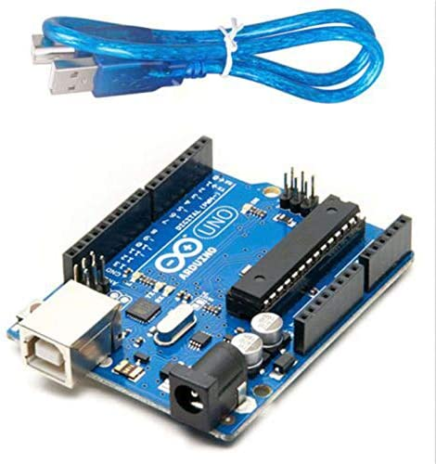
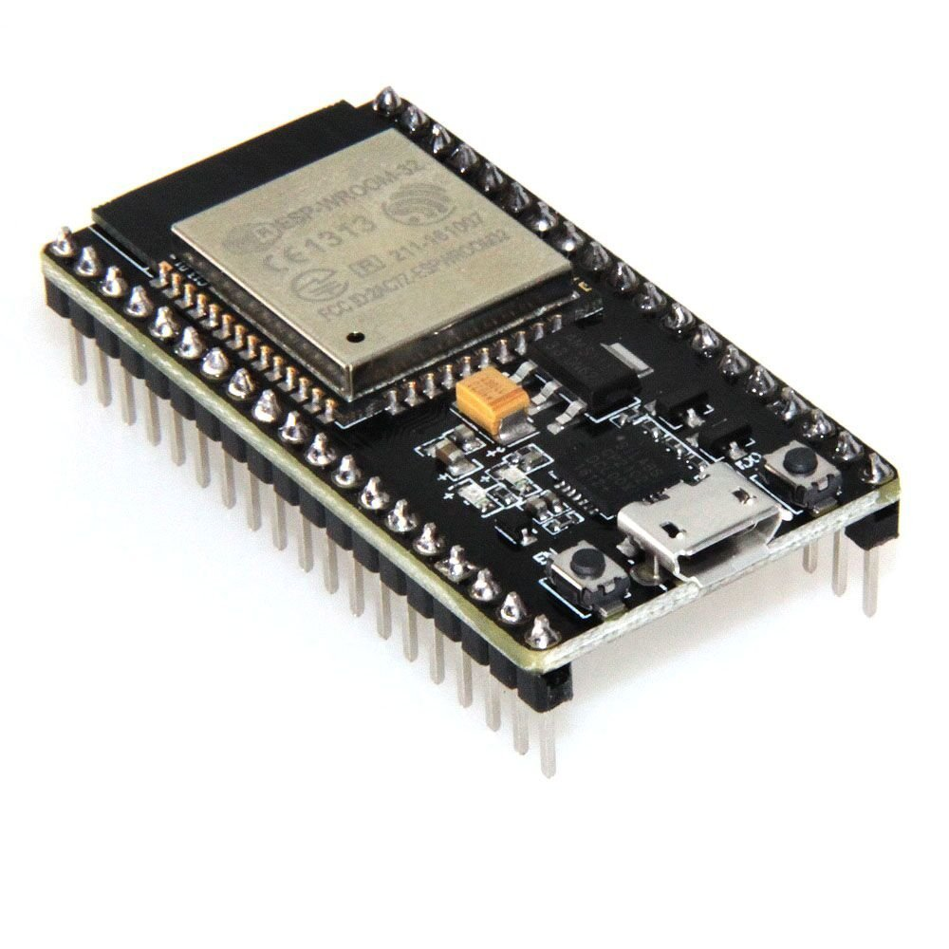
Arduino & ESP32
www.codehafeez.com

Slide 2
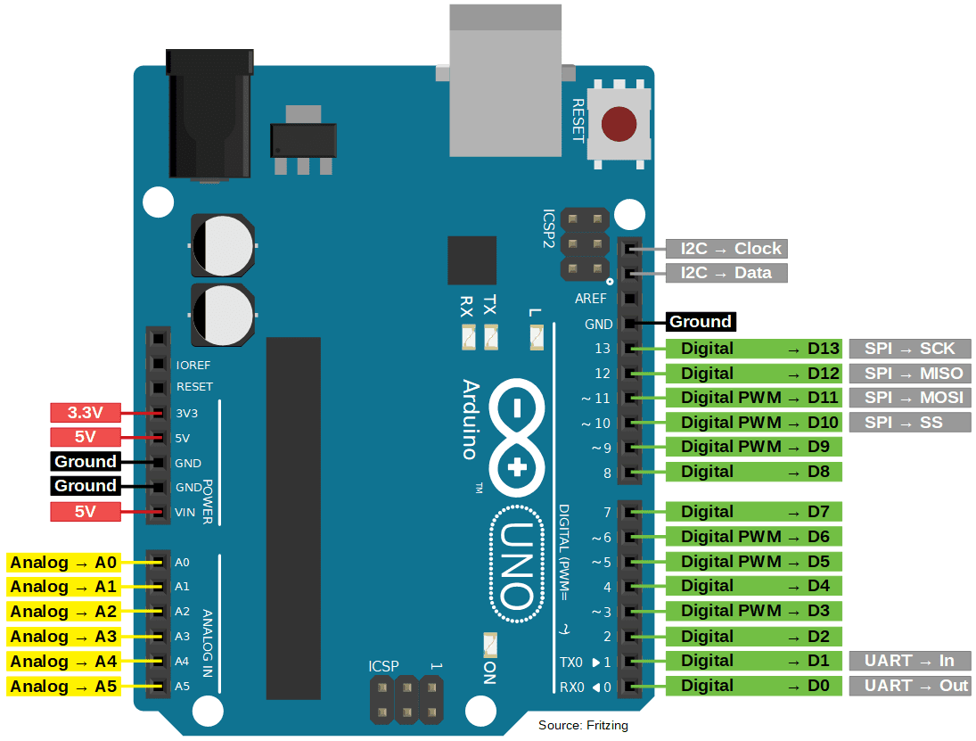
Arduino GPIO Pins

Slide 3
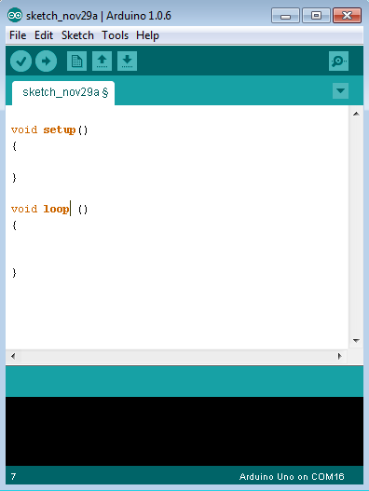
Arduino programs can be divided in three main parts: Structure, Values (variables and constants), and Functions.
Let us start with the Structure. Software structure consist of two main functions −
1) Setup( ) function
The setup function will only run once, after each power up or reset of the Arduino board.
2) Loop( ) function
After creating a setup() function, which initializes and sets the initial values, the loop() function does precisely what its name suggests, and loops consecutively, allowing your program to change and respond. Use it to actively control the Arduino board.

Slide 4
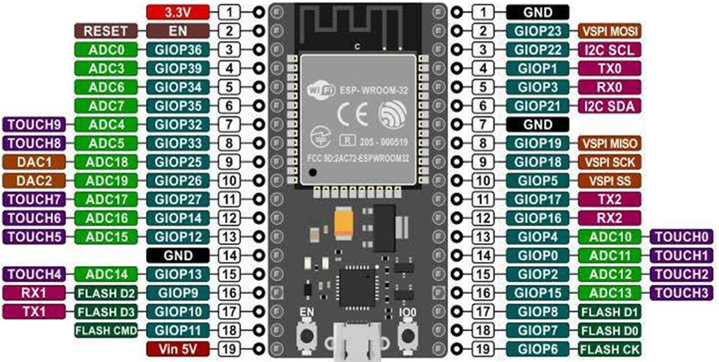
ESP32 GPIO Pins

Slide 5
ESP32 – Board LED
#define ONBOARD_LED 2
void setup() {
pinMode(ONBOARD_LED,OUTPUT);
}
void loop() {
delay(1000);
digitalWrite(ONBOARD_LED,HIGH);
delay(100);
digitalWrite(ONBOARD_LED,LOW);
}

Slide 6
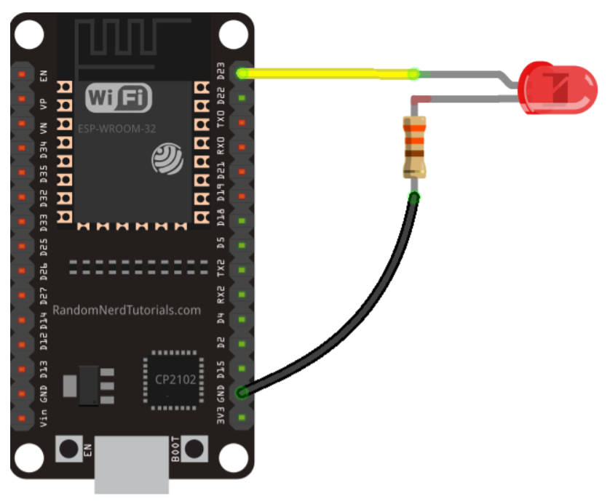
ESP32 – LED
const int LEDPIN = 2;
void setup(){
pinMode(LEDPIN, OUTPUT);
}
void loop() {
digitalWrite(LEDPIN, HIGH);
delay(1000);
digitalWrite(LEDPIN, LOW);
delay(1000);
}

Slide 7
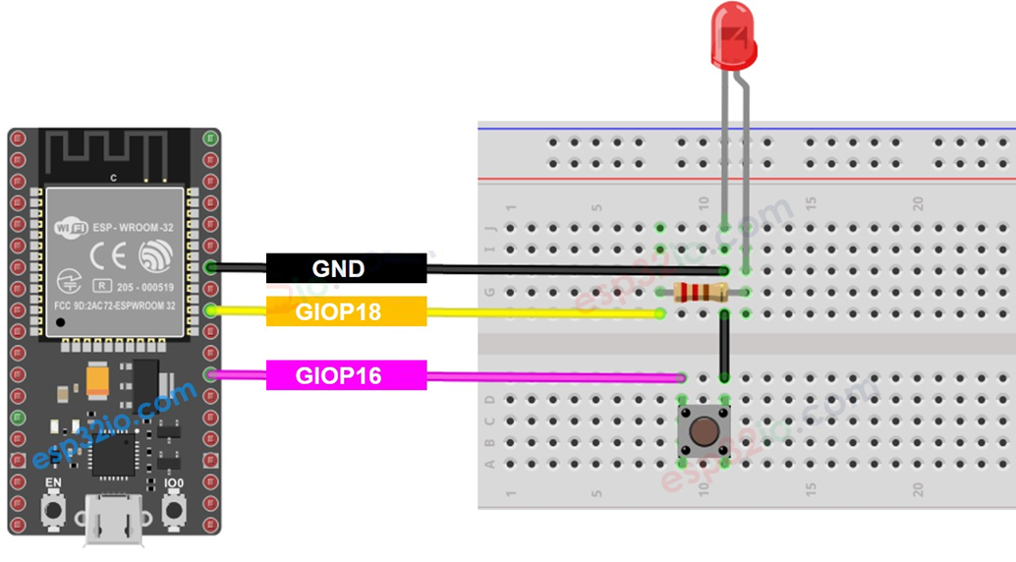
const int BUTTON_PIN = 16;
const int LED_PIN = 18;
int ledState = LOW;
int lastButtonState;
int currentButtonState;
void setup() {
Serial.begin(9600);
pinMode(BUTTON_PIN, INPUT_PULLUP);
pinMode(LED_PIN, OUTPUT);
currentButtonState = digitalRead(BUTTON_PIN);
}
void loop() {
lastButtonState = currentButtonState; // save the last state
currentButtonState = digitalRead(BUTTON_PIN); // read new state
if(lastButtonState == HIGH && currentButtonState == LOW) {
Serial.println("The button is pressed");
ledState = !ledState;
digitalWrite(LED_PIN, ledState);
}
}

Slide 8
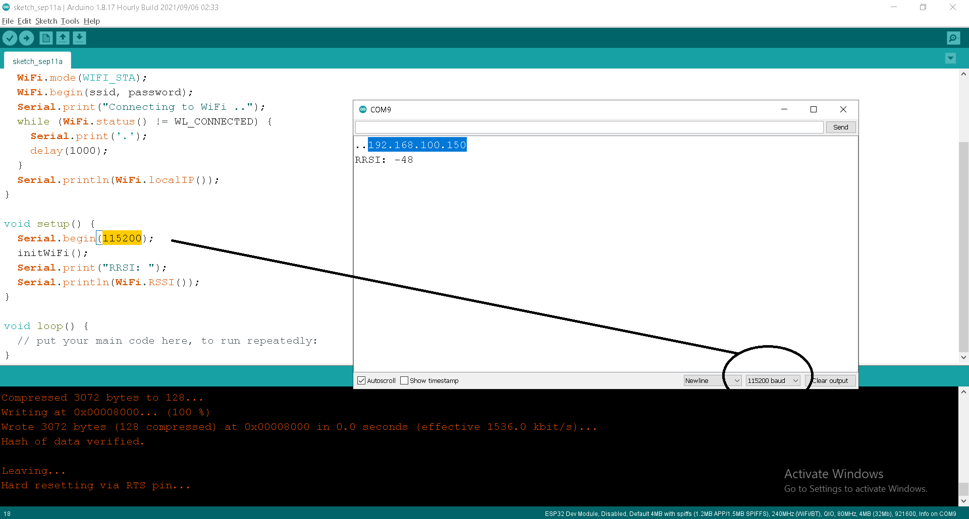
ESP32 Wifi IP
#include <WiFi.h>
const char* ssid = "Perfect vision 4G";
const char* password = "love2030vision";
void initWiFi() {
WiFi.mode(WIFI_STA);
WiFi.begin(ssid, password);
Serial.print("Connecting to WiFi ..");
while (WiFi.status() != WL_CONNECTED) {
Serial.print('.');
delay(1000);
}
Serial.println(WiFi.localIP());
}
void setup() {
Serial.begin(115200);
initWiFi();
Serial.print("RRSI: ");
Serial.println(WiFi.RSSI());
}
void loop() {
// put your main code here, to run repeatedly:
}

Slide 9
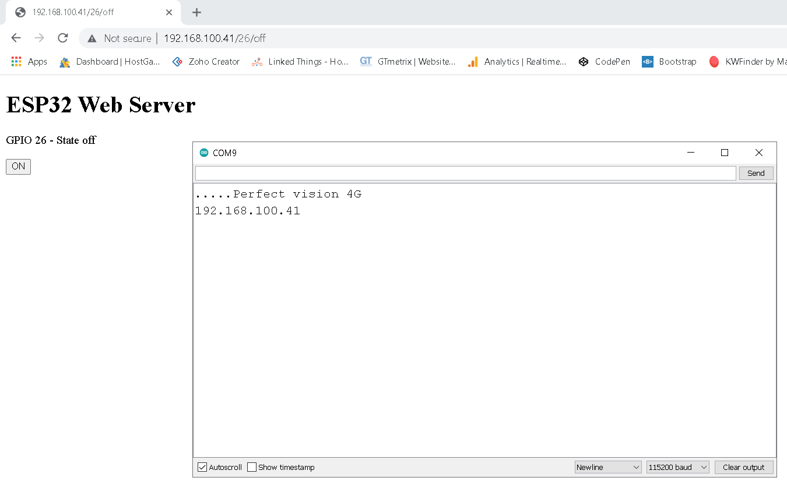
#include <WiFi.h>
const char* ssid = "Perfect vision 4G";
const char* password = "love2030vision";
WiFiServer server(80);
String myHeaderReq;
String output26State = "off";
const int output26 = 26;
unsigned long currentTime = millis();
unsigned long previousTime = 0;
const long timeoutTime = 2000;
void setup() {
Serial.begin(115200);
pinMode(output26, OUTPUT);
digitalWrite(output26, LOW);
WiFi.begin(ssid, password);
while (WiFi.status() != WL_CONNECTED) {
delay(500);
Serial.print(".");
}
Serial.println(ssid);
Serial.println(WiFi.localIP());
server.begin();
}
void loop(){
WiFiClient client = server.available();
if (client) {
currentTime = millis();
previousTime = currentTime;
Serial.println("New Client.");
String currentLine = "";
while (client.connected() && currentTime - previousTime <= timeoutTime) {
currentTime = millis();
if (client.available()) {
char c = client.read();
myHeaderReq += c;
if (c == '\n') {
if (myHeaderReq.indexOf("GET /26/on") >= 0) {
Serial.println("GPIO 26 on");
output26State = "on";
digitalWrite(output26, HIGH);
} else if (myHeaderReq.indexOf("GET /26/off") >= 0) {
Serial.println("GPIO 26 off");
output26State = "off";
digitalWrite(output26, LOW);
}
client.println("<!DOCTYPE html><html><body>");
client.println("<h1>ESP32 Web Server</h1>");
client.println("<p>GPIO 26 - State " + output26State + "</p>");
if (output26State=="off") {
client.println("<p><a href='/26/on'><button>ON</button></a></p>");
} else {
client.println("<p><a href='/26/off'><button>OFF</button></a></p>");
}
client.println("</body></html>");
break;
}
}
}
myHeaderReq = "";
client.stop();
Serial.println("Client disconnected.");
}
}

Slide 10
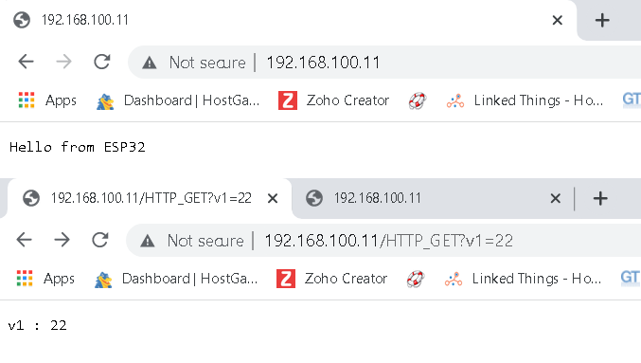
#include <ESP32WebServer.h>
#include <WiFi.h>
const char* ssid = "Perfect vision 4G";
const char* password = "love2030vision";
ESP32WebServer server(80);
void handleRoot() {
server.send(200, "text/plain", "Hello from ESP32");
}
void handleNotFound(){
String message = server.argName(0) + " : " + server.arg(0);
server.send(404, "text/plain", message);
}
void setup(){
Serial.begin(115200);
WiFi.begin(ssid, password);
while (WiFi.status() != WL_CONNECTED) {
delay(500);
Serial.print(".");
}
Serial.println(ssid);
Serial.print("IP address: ");
Serial.println(WiFi.localIP());
server.on("/", handleRoot);
server.onNotFound(handleNotFound);
server.begin();
Serial.println("HTTP server started");
}
void loop(){
server.handleClient();
}
ESP32WebServer - Pass data by URL
http://192.168.100.11/value1?v1=30&v2=34

Slide 11
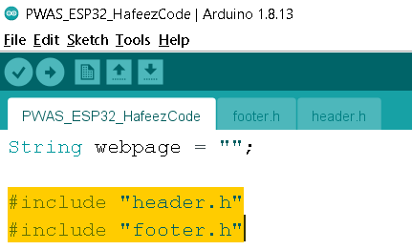
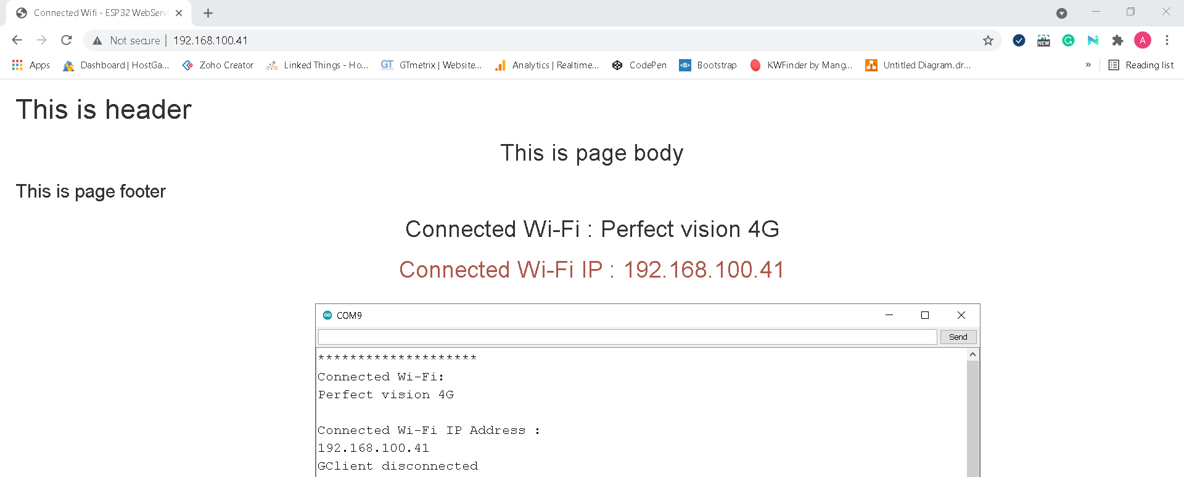
String webpage = "";
#include "header.h"
#include "footer.h"
#include <WiFi.h>
const char* ssid = "Perfect vision 4G";
const char* password = "love2030vision";
WiFiServer espServer(80);
void setup()
{
Serial.begin(115200);
WiFi.mode(WIFI_STA);
WiFi.begin(ssid, password);
while(WiFi.status() != WL_CONNECTED)
{
Serial.print("*");
delay(100);
}
Serial.print("\n");
Serial.println("Connected Wi-Fi: ");
Serial.println(WiFi.SSID());
Serial.print("\n");
Serial.println("Connected Wi-Fi IP Address : ");
espServer.begin();
Serial.println(WiFi.localIP());
}
void loop() {
WiFiClient client = espServer.available();
if(!client) { return; }
while (client.connected())
{
if (client.available())
{
char c = client.read();
Serial.write(c);
header_html_function();
webpage += F("<h2 style='text-align:center;'>This is page body</h2>");
footer_html_function();
client.println(webpage);
client.println("<h2 class='txt'>Connected Wi-Fi : "+WiFi.SSID()+"</h2>");
client.println("<h2 class='txt text1'>Connected Wi-Fi IP : "+WiFi.localIP().toString()+"</h2>");
break;
}
}
client.stop();
Serial.println("Client disconnected");
}
void header_html_function(){
webpage = F("<!DOCTYPE HTML>");
webpage += F("<html>");
webpage += F("<head>");
webpage += F("<meta charset='utf-8'>");
webpage += F("<meta name='viewport' content='width=device-width, initial-scale=1'>");
webpage += F("<link rel='stylesheet' href='https://maxcdn.bootstrapcdn.com/bootstrap/3.4.1/css/bootstrap.min.css'>");
webpage += F("<title>Connected Wifi - ESP32 WebServices</title>");
webpage += F("<style>");
webpage += F("body { margin:20px; }");
webpage += F(".txt { text-align:center; }");
webpage += F(".text1 { color:#ad594c; text-align:center; }");
webpage += F("</style>");
webpage += F("</head>");
webpage += F("<body>");
webpage += F("<h1>This is header</h1>");
}
void footer_html_function(){
webpage += F("<h3>This is page footer</h3>");
webpage += F("</body></html>");
}

Slide 12
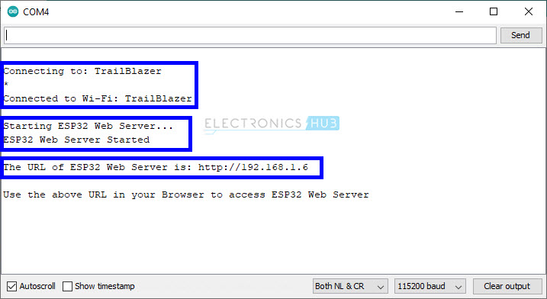
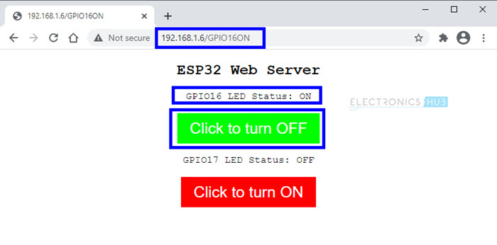
#include <WiFi.h>
#define gpio16LEDPin 16 /* One LED connected to GPIO16 - RX2 */
#define gpio17LEDPin 17 /* One LED connected to GPIO17 - TX2 */
const char* ssid = "Perfect vision 4G"; /* Add your router's SSID */
const char* password = "love2030vision"; /*Add the password */
int gpio16Value;
int gpio17Value;
WiFiServer espServer(80); /* Instance of WiFiServer with port number 80 */
/* 80 is the Port Number for HTTP Web Server */
/* A String to capture the incoming HTTP GET Request */
String request;
void setup()
{
Serial.begin(115200); /* Begin Serial Communication with 115200 Baud Rate */
/* Configure GPIO16 and GPIO17 Pins as OUTPUTs */
pinMode(gpio16LEDPin, OUTPUT);
pinMode(gpio17LEDPin, OUTPUT);
/* Set the initial values of GPIO16 and GPIO17 as LOW*/
/* Both the LEDs are initially OFF */
digitalWrite(gpio16LEDPin, LOW);
digitalWrite(gpio17LEDPin, LOW);
Serial.print("\n");
Serial.print("Connecting to: ");
Serial.println(ssid);
WiFi.mode(WIFI_STA); /* Configure ESP32 in STA Mode */
WiFi.begin(ssid, password); /* Connect to Wi-Fi based on the above SSID and Password */
while(WiFi.status() != WL_CONNECTED)
{
Serial.print("*");
delay(100);
}
Serial.print("\n");
Serial.print("Connected to Wi-Fi: ");
Serial.println(WiFi.SSID());
delay(100);
/* The next four lines of Code are used for assigning Static IP to ESP32 */
/* Do this only if you know what you are doing */
/* You have to check for free IP Addresses from your Router and */
/* assign it to ESP32 */
/* If you are comfortable with this step, */
/* please un-comment the next four lines and make necessary changes */
/* If not, leave it as it is and proceed */
//IPAddress ip(192,168,1,6);
//IPAddress gateway(192,168,1,1);
//IPAddress subnet(255,255,255,0);
//WiFi.config(ip, gateway, subnet);
delay(2000);
Serial.print("\n");
Serial.println("Starting ESP32 Web Server...");
espServer.begin(); /* Start the HTTP web Server */
Serial.println("ESP32 Web Server Started");
Serial.print("\n");
Serial.print("The URL of ESP32 Web Server is: ");
Serial.print("http://");
Serial.println(WiFi.localIP());
Serial.print("\n");
Serial.println("Use the above URL in your Browser to access ESP32 Web Server\n");
}
void loop()
{
WiFiClient client = espServer.available(); /* Check if a client is available */
if(!client)
{
return;
}
Serial.println("New Client!!!");
boolean currentLineIsBlank = true;
while (client.connected())
{
if (client.available())
{
char c = client.read();
request += c;
Serial.write(c);
/* if you've gotten to the end of the line (received a newline */
/* character) and the line is blank, the http request has ended, */
/* so you can send a reply */
if (c == '\n' && currentLineIsBlank)
{
/* Extract the URL of the request */
/* We have four URLs. If IP Address is 192.168.1.6 (for example),
* then URLs are:
* 192.168.1.6/GPIO16ON
* 192.168.1.6/GPIO16OFF
* 192.168.1.6/GPIO17ON
* 192.168.1.6/GPIO17OFF
*/
/* Based on the URL from the request, turn the LEDs ON or OFF */
if (request.indexOf("/GPIO16ON") != -1)
{
Serial.println("GPIO16 LED is ON");
digitalWrite(gpio16LEDPin, HIGH);
gpio16Value = HIGH;
}
if (request.indexOf("/GPIO16OFF") != -1)
{
Serial.println("GPIO16 LED is OFF");
digitalWrite(gpio16LEDPin, LOW);
gpio16Value = LOW;
}
if (request.indexOf("/GPIO17ON") != -1)
{
Serial.println("GPIO17 LED is ON");
digitalWrite(gpio17LEDPin, HIGH);
gpio17Value = HIGH;
}
if (request.indexOf("/GPIO17OFF") != -1)
{
Serial.println("GPIO17 LED is OFF");
digitalWrite(gpio17LEDPin, LOW);
gpio17Value = LOW;
}
/* HTTP Response in the form of HTML Web Page */
client.println("HTTP/1.1 200 OK");
client.println("Content-Type: text/html");
client.println("Connection: close");
client.println(); // IMPORTANT
client.println("<!DOCTYPE HTML>");
client.println("<html>");
client.println("<head>");
client.println("<meta name=\"viewport\" content=\"width=device-width, initial-scale=1\">");
client.println("<link rel=\"icon\" href=\"data:,\">");
client.println("<style>");
client.println("html { font-family: Courier New; display: inline-block; margin: 0px auto; text-align: center;}");
client.println(".button {border: none; color: white; padding: 10px 20px; text-align: center;");
client.println("text-decoration: none; font-size: 25px; margin: 2px; cursor: pointer;}");
client.println(".button1 {background-color: #FF0000;}");
client.println(".button2 {background-color: #00FF00;}");
client.println("</style>");
client.println("</head>");
client.println("<body>");
client.println("<h2>ESP32 Web Server</h2>");
if(gpio16Value == LOW)
{
client.println("<p>GPIO16 LED Status: OFF</p>");
client.print("<p><a href=\"/GPIO16ON\"><button class=\"button button1\">Click to turn ON</button></a></p>");
}
else
{
client.println("<p>GPIO16 LED Status: ON</p>");
client.print("<p><a href=\"/GPIO16OFF\"><button class=\"button button2\">Click to turn OFF</button></a></p>");
}
if(gpio17Value == LOW)
{
client.println("<p>GPIO17 LED Status: OFF</p>");
client.print("<p><a href=\"/GPIO17ON\"><button class=\"button button1\">Click to turn ON</button></a></p>");
}
else
{
client.println("<p>GPIO17 LED Status: ON</p>");
client.print("<p><a href=\"/GPIO17OFF\"><button class=\"button button2\">Click to turn OFF</button></a></p>");
}
client.println("</body>");
client.println("</html>");
break;
}
if(c == '\n')
{
currentLineIsBlank = true;
}
else if(c != '\r')
{
currentLineIsBlank = false;
}
//client.print("\n");
}
}
delay(1);
request = "";
//client.flush();
client.stop();
Serial.println("Client disconnected");
Serial.print("\n");
}
LED ON / OFF
ESP32 Web Server
https://www.electronicshub.org/esp32-web-server/

Slide 13
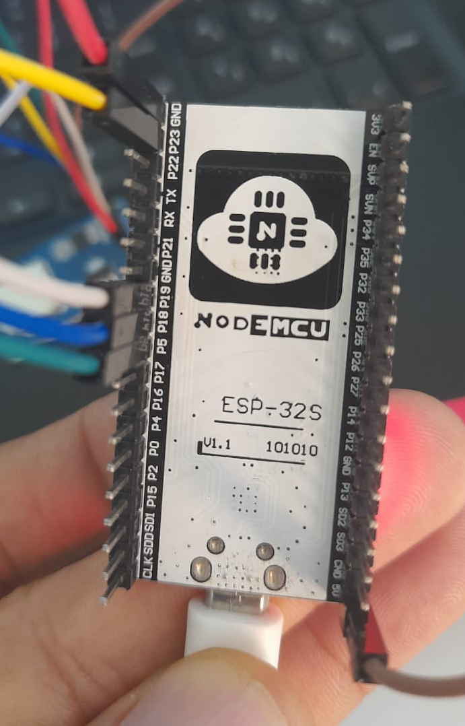
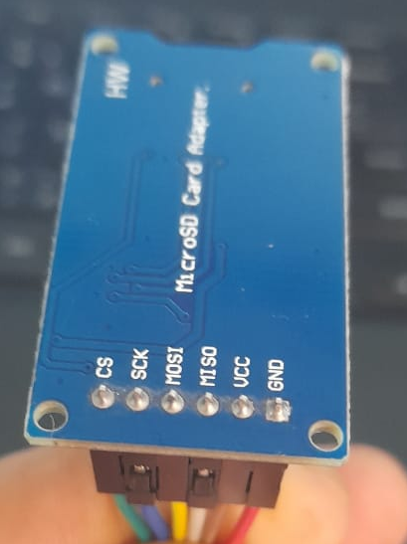
ESP32 – SD Card with File Operations
/*
* Connect the SD card to the following pins:
*
* SD Card | ESP32
* D2 -
* D3 SS
* CMD MOSI
* VSS GND
* VDD 3.3V
* CLK SCK
* VSS GND
* D0 MISO
* D1 -
*/
#include "FS.h"
#include "SD.h"
#include "SPI.h"
void listDir(fs::FS &fs, const char * dirname, uint8_t levels){
Serial.printf("Listing directory: %s\n", dirname);
File root = fs.open(dirname);
if(!root){
Serial.println("Failed to open directory");
return;
}
if(!root.isDirectory()){
Serial.println("Not a directory");
return;
}
File file = root.openNextFile();
while(file){
if(file.isDirectory()){
Serial.print(" DIR : ");
Serial.println(file.name());
if(levels){
listDir(fs, file.name(), levels -1);
}
} else {
Serial.print(" FILE: ");
Serial.print(file.name());
Serial.print(" SIZE: ");
Serial.println(file.size());
}
file = root.openNextFile();
}
}
void createDir(fs::FS &fs, const char * path){
Serial.printf("Creating Dir: %s\n", path);
if(fs.mkdir(path)){
Serial.println("Dir created");
} else {
Serial.println("mkdir failed");
}
}
void removeDir(fs::FS &fs, const char * path){
Serial.printf("Removing Dir: %s\n", path);
if(fs.rmdir(path)){
Serial.println("Dir removed");
} else {
Serial.println("rmdir failed");
}
}
void readFile(fs::FS &fs, const char * path){
Serial.printf("Reading file: %s\n", path);
File file = fs.open(path);
if(!file){
Serial.println("Failed to open file for reading");
return;
}
Serial.print("Read from file: ");
while(file.available()){
Serial.write(file.read());
}
file.close();
}
void writeFile(fs::FS &fs, const char * path, const char * message){
Serial.printf("Writing file: %s\n", path);
File file = fs.open(path, FILE_WRITE);
if(!file){
Serial.println("Failed to open file for writing");
return;
}
if(file.print(message)){
Serial.println("File written");
} else {
Serial.println("Write failed");
}
file.close();
}
void appendFile(fs::FS &fs, const char * path, const char * message){
Serial.printf("Appending to file: %s\n", path);
File file = fs.open(path, FILE_APPEND);
if(!file){
Serial.println("Failed to open file for appending");
return;
}
if(file.print(message)){
Serial.println("Message appended");
} else {
Serial.println("Append failed");
}
file.close();
}
void renameFile(fs::FS &fs, const char * path1, const char * path2){
Serial.printf("Renaming file %s to %s\n", path1, path2);
if (fs.rename(path1, path2)) {
Serial.println("File renamed");
} else {
Serial.println("Rename failed");
}
}
void deleteFile(fs::FS &fs, const char * path){
Serial.printf("Deleting file: %s\n", path);
if(fs.remove(path)){
Serial.println("File deleted");
} else {
Serial.println("Delete failed");
}
}
void testFileIO(fs::FS &fs, const char * path){
File file = fs.open(path);
static uint8_t buf[512];
size_t len = 0;
uint32_t start = millis();
uint32_t end = start;
if(file){
len = file.size();
size_t flen = len;
start = millis();
while(len){
size_t toRead = len;
if(toRead > 512){
toRead = 512;
}
file.read(buf, toRead);
len -= toRead;
}
end = millis() - start;
Serial.printf("%u bytes read for %u ms\n", flen, end);
file.close();
} else {
Serial.println("Failed to open file for reading");
}
file = fs.open(path, FILE_WRITE);
if(!file){
Serial.println("Failed to open file for writing");
return;
}
size_t i;
start = millis();
for(i=0; i<2048; i++){
file.write(buf, 512);
}
end = millis() - start;
Serial.printf("%u bytes written for %u ms\n", 2048 * 512, end);
file.close();
}
void setup(){
Serial.begin(115200);
if(!SD.begin()){
Serial.println("Card Mount Failed");
return;
}
uint8_t cardType = SD.cardType();
if(cardType == CARD_NONE){
Serial.println("No SD card attached");
return;
}
Serial.print("SD Card Type: ");
if(cardType == CARD_MMC){
Serial.println("MMC");
} else if(cardType == CARD_SD){
Serial.println("SDSC");
} else if(cardType == CARD_SDHC){
Serial.println("SDHC");
} else {
Serial.println("UNKNOWN");
}
uint64_t cardSize = SD.cardSize() / (1024 * 1024);
Serial.printf("SD Card Size: %lluMB\n", cardSize);
listDir(SD, "/", 0);
createDir(SD, "/mydir");
listDir(SD, "/", 0);
removeDir(SD, "/mydir");
listDir(SD, "/", 2);
writeFile(SD, "/hello.txt", "Hello ");
appendFile(SD, "/hello.txt", "World!\n");
readFile(SD, "/hello.txt");
deleteFile(SD, "/foo.txt");
renameFile(SD, "/hello.txt", "/foo.txt");
readFile(SD, "/foo.txt");
testFileIO(SD, "/test.txt");
Serial.printf("Total space: %lluMB\n", SD.totalBytes() / (1024 * 1024));
Serial.printf("Used space: %lluMB\n", SD.usedBytes() / (1024 * 1024));
}
void loop(){
}

Slide 14
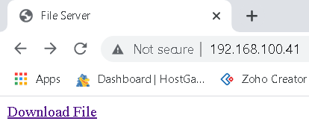
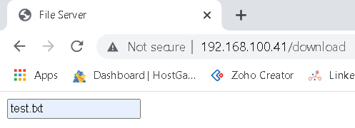
ESP32 – SD Card Download File
#include <WiFi.h>
#include <ESP32WebServer.h>
#include <SD.h>
const char* ssid = "Perfect vision 4G";
const char* password = "love2030vision";
ESP32WebServer server(80);
String webpage = "";
bool SD_present = false;
//~~~~~~~~~~~~~~~~~~~~~~~~~~~~~~~~~~~~~~~~~~~~~~~~~~~~~~~~~~~~~~~~~~~~~~~~~~~
void setup(){
Serial.begin(115200);
WiFi.begin(ssid, password);
Serial.print("Connecting to WiFi ..");
while (WiFi.status() != WL_CONNECTED) {
Serial.print('.');
delay(1000);
}
Serial.println("\nConnected to "+WiFi.SSID()+" Use IP address: "+WiFi.localIP().toString());
Serial.print(F("Initializing SD card..."));
if (!SD.begin(5)) {
Serial.println(F("Card failed or not present, no SD Card data logging possible..."));
SD_present = false;
}
else {
Serial.println(F("Card initialised... file access enabled..."));
SD_present = true;
}
server.on("/", HomePage);
server.on("/download", File_Download);
server.begin();
Serial.println("HTTP server started");
}
//~~~~~~~~~~~~~~~~~~~~~~~~~~~~~~~~~~~~~~~~~~~~~~~~~~~~~~~~~~~~~~~~~~~~~~~~~~~
void loop(){
server.handleClient();
}
//~~~~~~~~~~~~~~~~~~~~~~~~~~~~~~~~~~~~~~~~~~~~~~~~~~~~~~~~~~~~~~~~~~~~~~~~~~~
void HomePage(){
webpage = F("<!DOCTYPE html><html><head><title>File Server</title></head><body>");
webpage += F("<a href='/download'>Download File</a></body></html>");
server.sendContent(webpage);
webpage = "";
server.sendContent("");
server.client().stop();
}
//~~~~~~~~~~~~~~~~~~~~~~~~~~~~~~~~~~~~~~~~~~~~~~~~~~~~~~~~~~~~~~~~~~~~~~~~~~~
void File_Download(){
if (server.args() > 0 ) {
if (server.hasArg("download")) SD_file_download(server.arg(0));
}
else SelectInput("File Download","Enter filename to download","download","download");
}
//~~~~~~~~~~~~~~~~~~~~~~~~~~~~~~~~~~~~~~~~~~~~~~~~~~~~~~~~~~~~~~~~~~~~~~~~~~~
void SD_file_download(String filename){
if (SD_present) {
File download = SD.open("/"+filename);
if (download) {
server.sendHeader("Content-Type", "text/text");
server.sendHeader("Content-Disposition", "attachment; filename="+filename);
server.sendHeader("Connection", "close");
server.streamFile(download, "application/octet-stream");
download.close();
} else ReportFileNotPresent("download");
} else ReportSDNotPresent();
}
//~~~~~~~~~~~~~~~~~~~~~~~~~~~~~~~~~~~~~~~~~~~~~~~~~~~~~~~~~~~~~~~~~~~~~~~~~~~
void SelectInput(String heading1, String heading2, String command, String arg_calling_name){
server.sendHeader("Cache-Control", "no-cache, no-store, must-revalidate");
server.sendHeader("Pragma", "no-cache");
server.sendHeader("Expires", "-1");
server.setContentLength(CONTENT_LENGTH_UNKNOWN);
server.send(200, "text/html", "");
webpage = F("<!DOCTYPE html><html><head><title>File Server</title></head><body>");
webpage += F("<FORM action='/");
webpage += command + "' method='post'>";
webpage += F("<input type='text' name='");
webpage += arg_calling_name;
webpage += F("' value=''><br>");
webpage += F("<type='submit' name='");
webpage += arg_calling_name;
webpage += F("' value=''><br><br>");
webpage += F("</body></html>");
server.sendContent(webpage);
webpage = "";
server.sendContent("");
server.client().stop();
}
//~~~~~~~~~~~~~~~~~~~~~~~~~~~~~~~~~~~~~~~~~~~~~~~~~~~~~~~~~~~~~~~~~~~~~~~~~~~
void ReportSDNotPresent(){
server.sendHeader("Cache-Control", "no-cache, no-store, must-revalidate");
server.sendHeader("Pragma", "no-cache");
server.sendHeader("Expires", "-1");
server.setContentLength(CONTENT_LENGTH_UNKNOWN);
server.send(200, "text/html", "");
webpage = F("<!DOCTYPE html><html><head><title>File Server</title></head><body>");
webpage += F("<h3>No SD Card present</h3></body></html>");
server.sendContent(webpage);
webpage = "";
server.sendContent("");
server.client().stop();
}
//~~~~~~~~~~~~~~~~~~~~~~~~~~~~~~~~~~~~~~~~~~~~~~~~~~~~~~~~~~~~~~~~~~~~~~~~~~~
void ReportFileNotPresent(String target){
server.sendHeader("Cache-Control", "no-cache, no-store, must-revalidate");
server.sendHeader("Pragma", "no-cache");
server.sendHeader("Expires", "-1");
server.setContentLength(CONTENT_LENGTH_UNKNOWN);
server.send(200, "text/html", "");
webpage = F("<!DOCTYPE html><html><head><title>File Server</title></head><body>");
webpage += F("<h3>File does not exist</h3></body></html>");
server.sendContent(webpage);
webpage = "";
server.sendContent("");
server.client().stop();
}

Slide 15
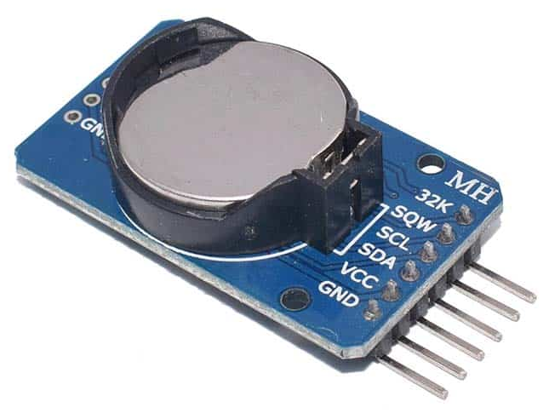
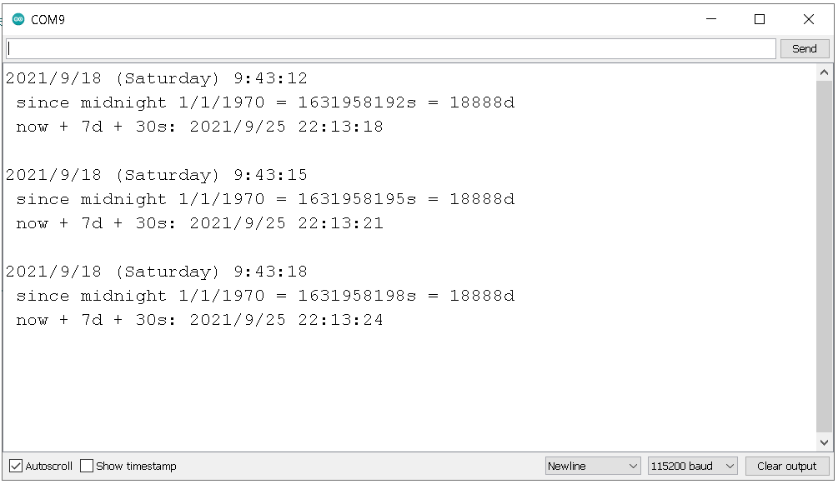
#include "RTClib.h"
RTC_DS3231 rtc;
char daysOfTheWeek[7][12] = {"Sunday", "Monday", "Tuesday", "Wednesday", "Thursday", "Friday", "Saturday"};
void setup ()
{
Serial.begin(115200);
delay(3000);
if (! rtc.begin()) {
Serial.println("Couldn't find RTC");
while (1);
}
if (rtc.lostPower()) {
Serial.println("RTC lost power, lets set the time!");
rtc.adjust(DateTime(F(__DATE__), F(__TIME__)));
}
}
void loop () {
DateTime now = rtc.now();
Serial.print(now.year(), DEC);
Serial.print('/');
Serial.print(now.month(), DEC);
Serial.print('/');
Serial.print(now.day(), DEC);
Serial.print(" (");
Serial.print(daysOfTheWeek[now.dayOfTheWeek()]);
Serial.print(") ");
Serial.print(now.hour(), DEC);
Serial.print(':');
Serial.print(now.minute(), DEC);
Serial.print(':');
Serial.print(now.second(), DEC);
Serial.println();
Serial.print(" since midnight 1/1/1970 = ");
Serial.print(now.unixtime());
Serial.print("s = ");
Serial.print(now.unixtime() / 86400L);
Serial.println("d");
// calculate a date which is 7 days and 30 seconds into the future
DateTime future (now + TimeSpan(7,12,30,6));
Serial.print(" now + 7d + 30s: ");
Serial.print(future.year(), DEC);
Serial.print('/');
Serial.print(future.month(), DEC);
Serial.print('/');
Serial.print(future.day(), DEC);
Serial.print(' ');
Serial.print(future.hour(), DEC);
Serial.print(':');
Serial.print(future.minute(), DEC);
Serial.print(':');
Serial.print(future.second(), DEC);
Serial.println();
Serial.println();
delay(3000);
}
RTC Pins | Module Pins
GND | GND
3v3 | VCC
21 | SDA
22 | SCL
EPS32 RTC Real Clock - Example

Slide 16
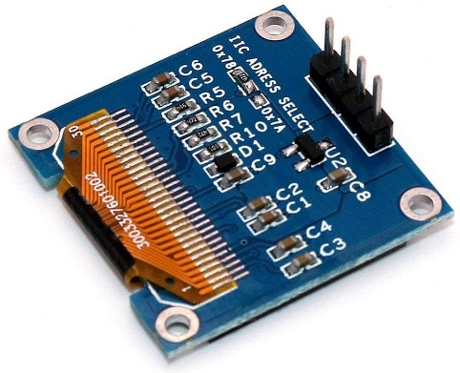
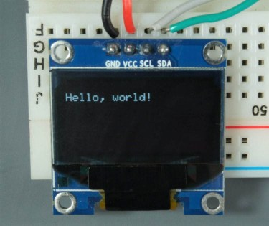
#include <Wire.h>
#include <Adafruit_GFX.h>
#include <Adafruit_SSD1306.h>
#define SCREEN_WIDTH 128 // OLED display width, in pixels
#define SCREEN_HEIGHT 64 // OLED display height, in pixels
Adafruit_SSD1306 display(SCREEN_WIDTH, SCREEN_HEIGHT, &Wire, -1);
void setup() {
Serial.begin(115200);
if(!display.begin(SSD1306_SWITCHCAPVCC, 0x3D)) {
Serial.println(F("SSD1306 allocation failed"));
for(;;);
}
delay(2000);
display.clearDisplay();
display.setTextSize(1);
display.setTextColor(WHITE);
display.setCursor(0, 10);
display.println("Hello, world!");
display.display();
}
void loop() {
}
OLED Pin | ESP32
Vin | 3.3V
GND | GND
SCL | GPIO 22
SDA | GPIO 21
ESP32 OLED - Example

Slide 17
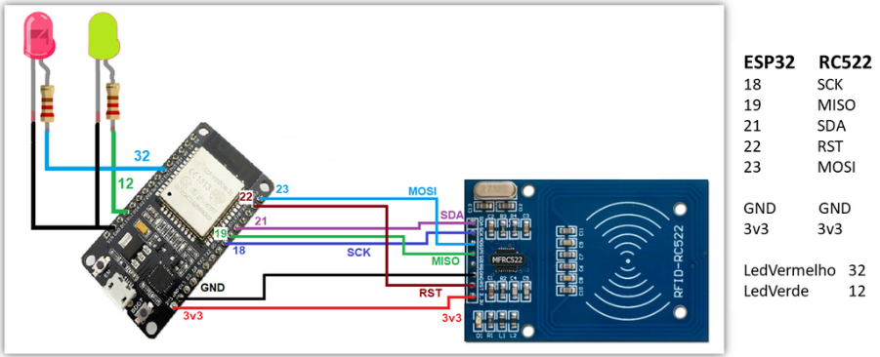
#include <SPI.h>
#include <MFRC522.h>
const int RST_PIN = 22; // Reset pin
const int SS_PIN = 21; // Slave select pin
MFRC522 mfrc522(SS_PIN, RST_PIN); // Create MFRC522 instance
void setup() {
Serial.begin(115200);
while (!Serial);
SPI.begin();
mfrc522.PCD_Init(); // Init MFRC522
mfrc522.PCD_DumpVersionToSerial(); // Show details of PCD - MFRC522 Card Reader details
Serial.println(F("Scan PICC to see UID, SAK, type, and data blocks..."));
}
void loop() {
// Look for new cards
if (! mfrc522.PICC_IsNewCardPresent()) { return; }
// Select one of the cards
if (! mfrc522.PICC_ReadCardSerial()) { return; }
mfrc522.PICC_DumpToSerial(&(mfrc522.uid));
}
EPS32 RFID - Example

